Slide 1
AI for Scientific Research with Better Agentic Search Systems
Chen Zhao
NYU Shanghai & NYU

Slide 2
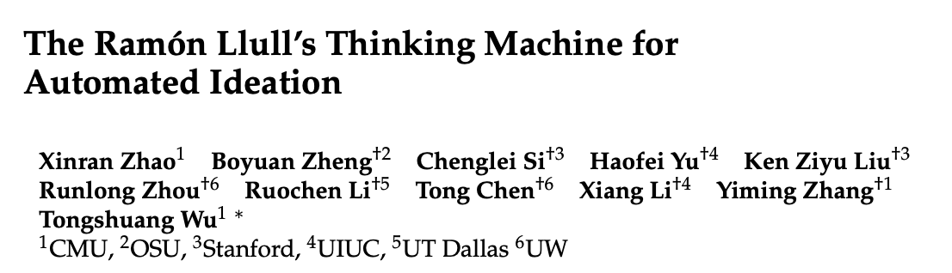

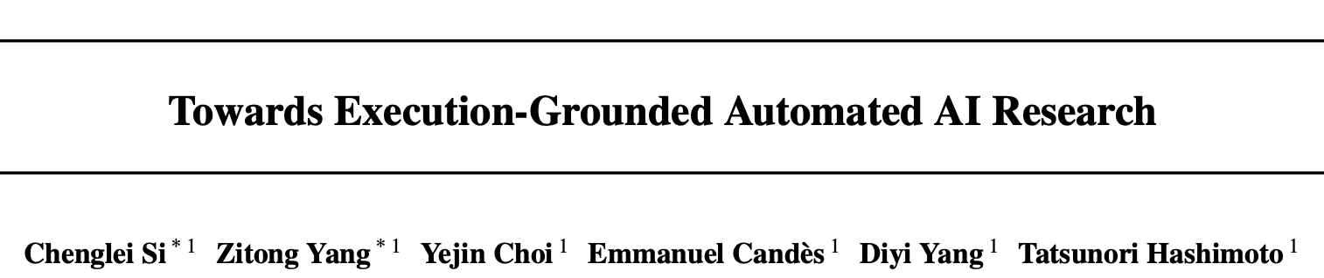
Agents for Research
Agents have been incorporated into every stage of research pipeline.
Idea Generation
Literature Search
Execution

Slide 3
Deep Research Agents
OpenAI Deep Research: You give it a prompt, and ChatGPT will find, analyze, and synthesize hundreds of online sources to create a comprehensive report at the level of a researcher.

Slide 4
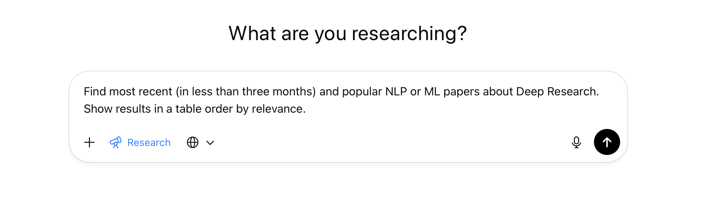
Deep Research Agents Framework

Slide 5
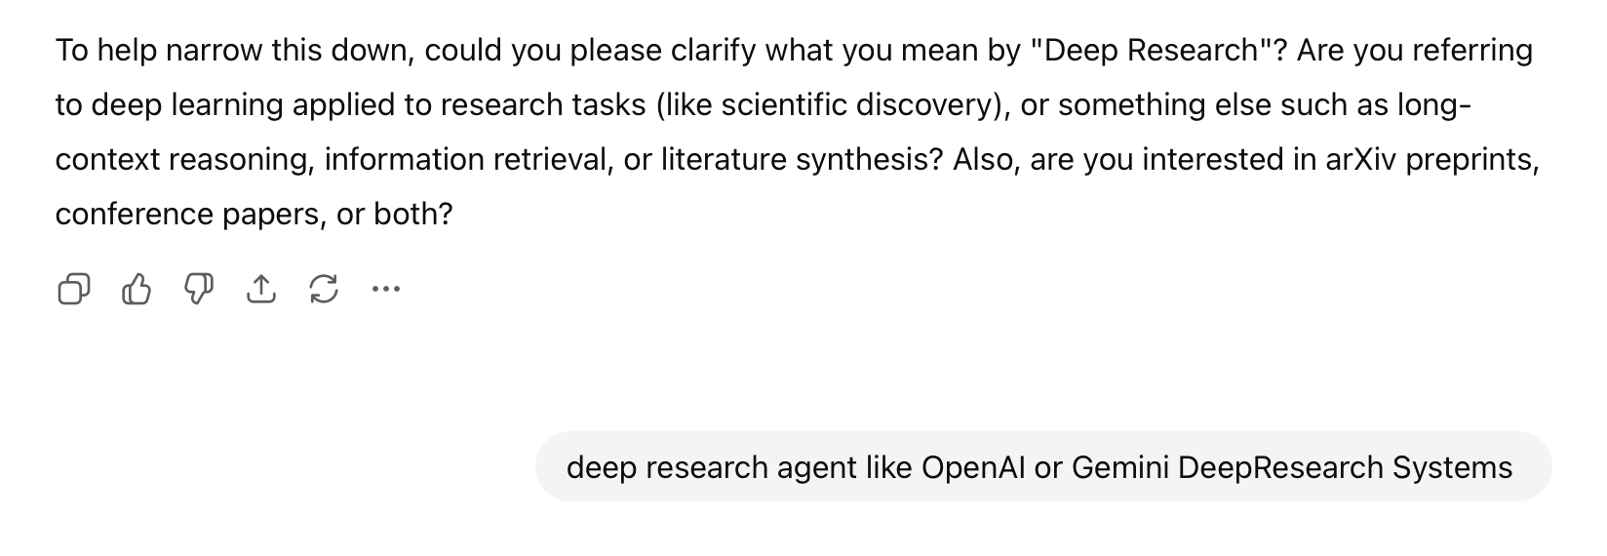
Deep Research Agents Framework
Ask Classification Questions

Slide 6
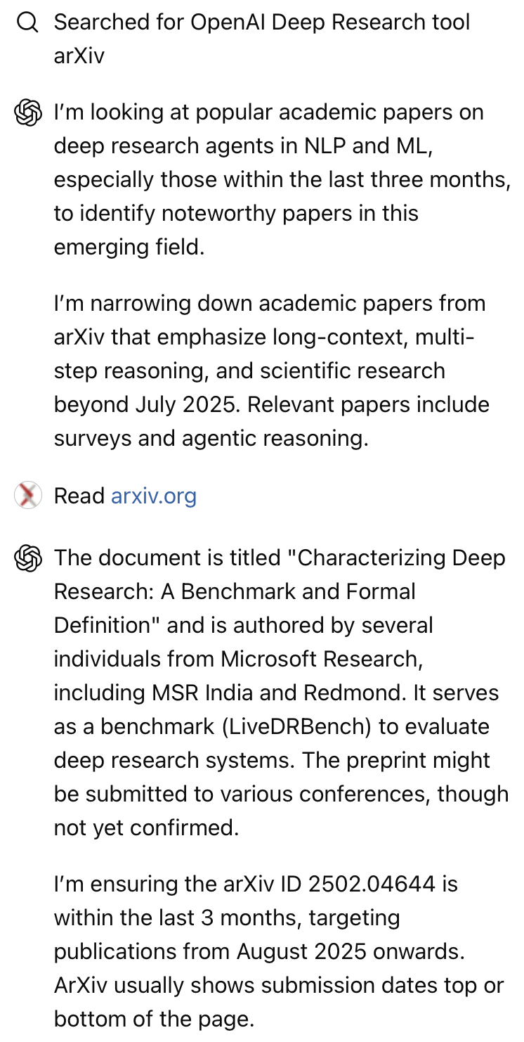
Deep Research Agents Framework
Ask Classification Questions
Search Multiple Rounds

Slide 7
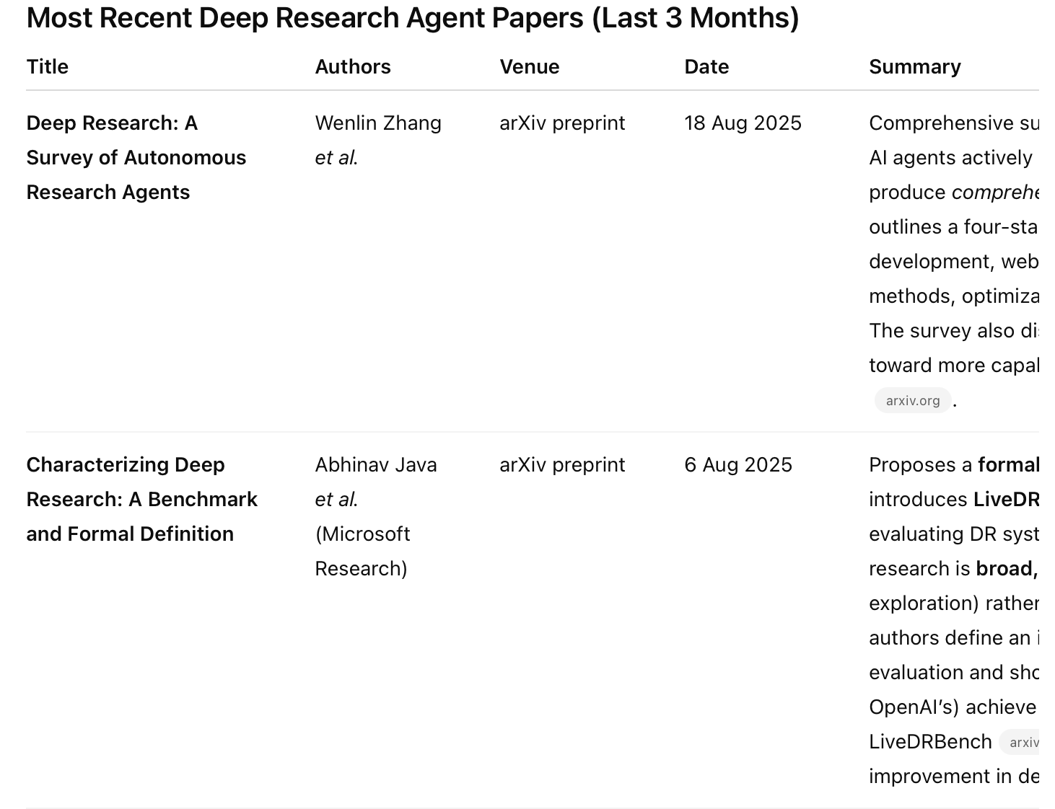
Deep Research Agents Framework
Ask Classification Questions
Search Multiple Rounds
Generate Report

Slide 8

What is behind Deep Research?

Slide 9
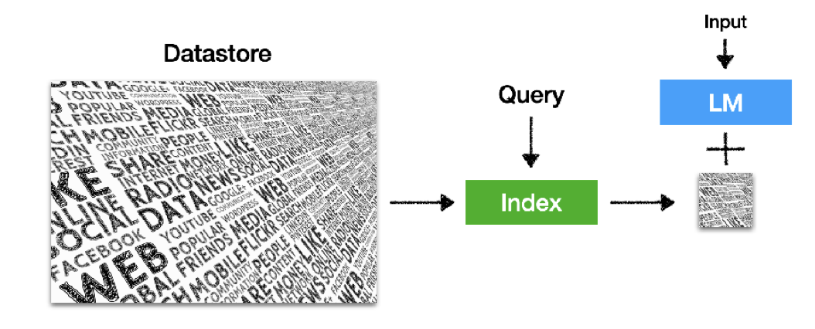
Pre 2025: Retrieval Augmented Generation
Retrieval-based LM = Retrieval + LMs (or commonly referred as RAG)
It retrieves from an external datastore

Slide 10
Definition of Agentic Search
A natural evolution of retrieval-augmented generation (RAG): Where LLM based agents actively plan, execute and refine research processes to achieve complex information-seeking goals.

Slide 11



My Understanding of Agentic Search
Goal:
Complex Information Seeking
REQ1
Planning: Parse the query, and generate the plan
REQ2
Retrieval: Finding relevant information from different dimensions
REQ3
Reasoning: Synthesis the information and output the report

Slide 12
My Understanding of Agentic Search
Goal:
Complex Information Seeking
REQ1
Planning: Parse the query, and generate the plan
REQ2
Retrieval: Finding relevant information from different dimensions
REQ3
Reasoning: Synthesis the information and output the report

Slide 13
Challenges in Retrieval: Paradigm Shift
Retrieval is always the foundation of RAG and agentic search systems: finding evidence to reason over.

Slide 14

Challenges in Retrieval: Paradigm Shift
With the help of Mid-training on synthetic data, LLM knowledge increases significantly
Retrieval is always the foundation of RAG and agentic search systems: finding evidence to reason over.
--- (Section 2.2) Knowledge data Rephrasing: Rephrasing Wikipedia 10 times

Slide 15
Challenges in Retrieval: Paradigm Shift
With the help of Mid-training on synthetic data, LLM knowledge increases significantly
Retrieval is always the foundation of RAG and agentic search systems: finding evidence to reason over.
--- (Section 2.2) Knowledge data Rephrasing: Rephrasing Wikipedia 10 times
Paradigm Shift: We must find new scenarios where retrieval actually helps! i.e., LLMs do not have enough parametric knowledge

Slide 16
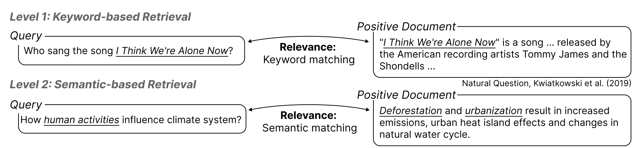
Challenges in Retrieval: Reasoning-Intensive
Existing agentic search systems mainly use Web search (e.g., call Google API), which only focuses on Level 1 and Level 2 Retrieval

Slide 17
Reasoning-intensive Retrieval
Motivation: Retrieval is bottleneck, existing retrievers only focus on relevance
Definition: Require intensive reasoning to find relevant information (e.g., documents)

Slide 18
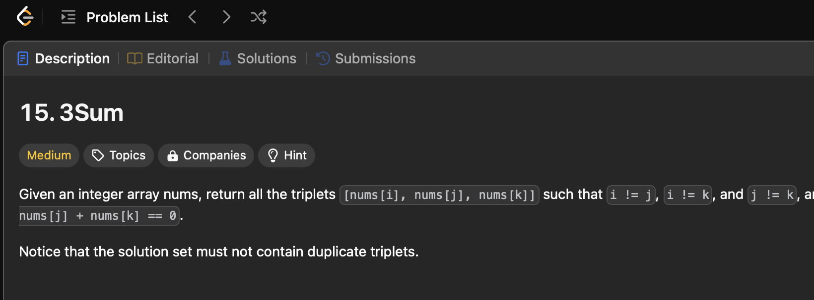
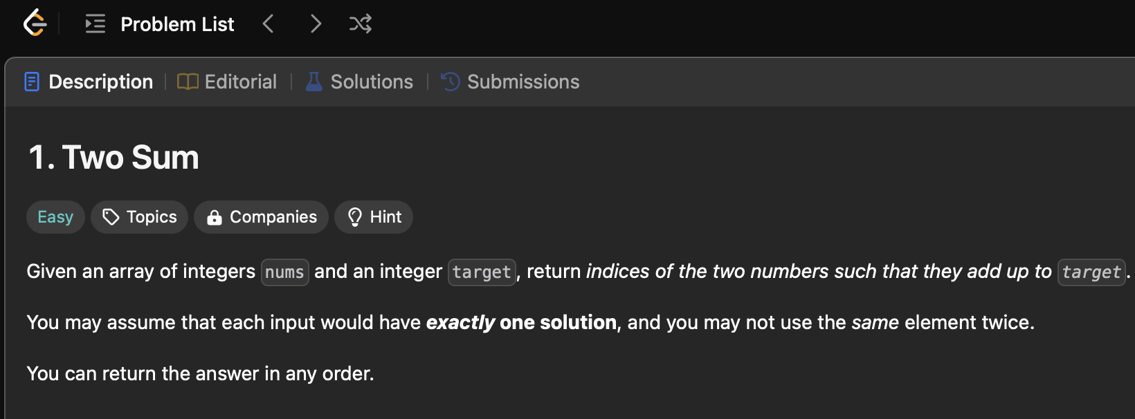
Reasoning-intensive Retrieval
Motivation: Retrieval is bottleneck, existing retrievers only focus on relevance
Definition: Require intensive reasoning to find relevant information (e.g., documents)
Example Real-world Scenario: Given a coding problem, finding relevant coding problems that share similar algorithm as solutions

Slide 19
Why Reasoning-intensive Retrieval important?
User queries, especially in AI for research, are often complex, with multiple detailed instructions
Deep research systems require multiple rounds of retrieval, but existing systems are only able to retrieve vague information
Better reasoning intensive retrieval systems can accurately locate fine grained and personalized information
Could you research the popular climbing shoes on the market in mid 2025 and made in Asia?

Slide 20


Outline
AI for Research with better agentic search systems
Text Diffusion Language Model for Reasoning-intensive Retrieval
(EMNLP 2025)
Benchmarking and Improving Retrieval for Deep Research Agents
(ACL 2026 Submission)
Knowledge G.
Inference
Future Directions

Slide 21
Outline
AI for Research with better agentic search systems
Text Diffusion Language Model for Reasoning-intensive Retrieval
(EMNLP 2025)
Benchmarking and Improving Retrieval for Deep Research Agents
(ACL 2026 Submission)
Knowledge G.
Inference
Future Directions

Slide 22
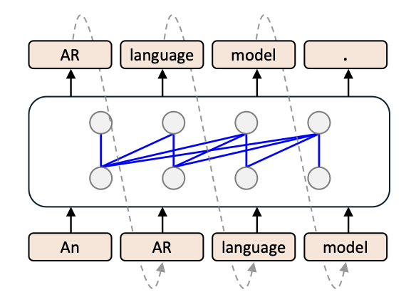
From Dense Retriever to LLM Embeddings
Mean pooling of last LLM layer representations
Benefit from large scale LLM pre-training and post-training
Have strong instruction following and reasoning capacities
Diffusion vs. Autoregressive Language Models: A Text Embedding Perspective Siyue Zhang, Yilun Zhao, Liyuan Geng, Arman Cohan, Anh Tuan Luu, Chen Zhao, EMNLP 2025 (Oral)

Slide 23
Challenges of LLM Embeddings
Unlike encoder only models (e.g., BERT), (decoder-only) LLMs only contains attention from one direction.
Retrieval is a task that needs global information
Engineering Mitigation: LLM2vec that adapts with bidirectional attention through continue training, but still limited in scale compared with LLM pre-training and post-training
Diffusion vs. Autoregressive Language Models: A Text Embedding Perspective Siyue Zhang, Yilun Zhao, Liyuan Geng, Arman Cohan, Anh Tuan Luu, Chen Zhao, EMNLP 2025 (Oral)

Slide 24
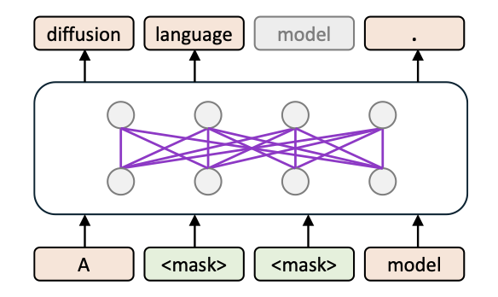
Discrete Text Diffusion Models
Discrete Text diffusion Model (e.g., Dream): start with pre-trained AR LM, add backward attention, and conduct denoising mid-training and post-training.
Advantage: global information
On par with AR LMs on reasoning benchmarks
Diffusion vs. Autoregressive Language Models: A Text Embedding Perspective Siyue Zhang, Yilun Zhao, Liyuan Geng, Arman Cohan, Anh Tuan Luu, Chen Zhao, EMNLP 2025 (Oral)

Slide 25
Text Diffusion Models as Retriever
Hypothesis: embeddings from diffusion models, when trained at scale with a bidirectional attention architecture, are better suited for reasoning-intensive retrieval
Diffusion vs. Autoregressive Language Models: A Text Embedding Perspective Siyue Zhang, Yilun Zhao, Liyuan Geng, Arman Cohan, Anh Tuan Luu, Chen Zhao, EMNLP 2025 (Oral)

Slide 26
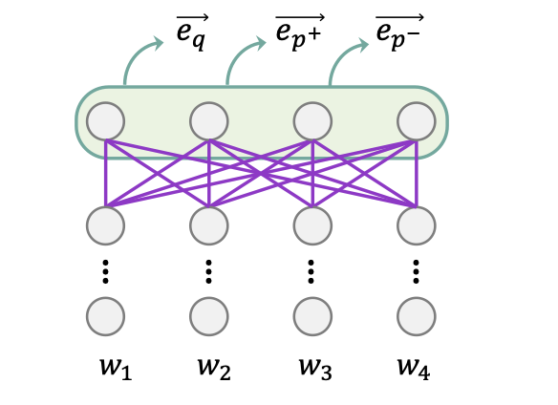
Text Diffusion Models as Retriever
Diffusion Embeddings: Mean pooling over final layer token representations
Diffusion vs. Autoregressive Language Models: A Text Embedding Perspective Siyue Zhang, Yilun Zhao, Liyuan Geng, Arman Cohan, Anh Tuan Luu, Chen Zhao, EMNLP 2025 (Oral)

Slide 27
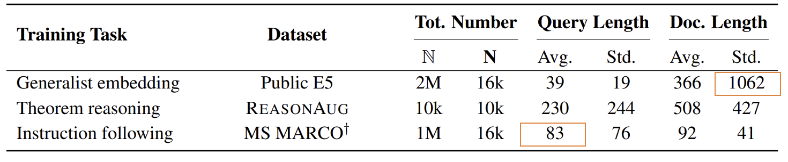
Compare LLM and Diffusion Embeddings
Diverse Tasks:
Long-document Retrieval
Reasoning-intensive Retrieval
Instruction-following Retrieval
General Text-embedding Tasks
Train Dataset | Test Dataset
E5 Public | LongEmbed
ReasonAug | BRIGHT
MS MARCO† | FollowIR
E5 Public | MTEB
Diffusion vs. Autoregressive Language Models: A Text Embedding Perspective Siyue Zhang, Yilun Zhao, Liyuan Geng, Arman Cohan, Anh Tuan Luu, Chen Zhao, EMNLP 2025 (Oral)

Slide 28
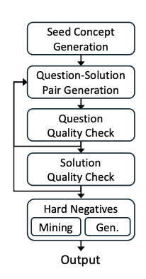
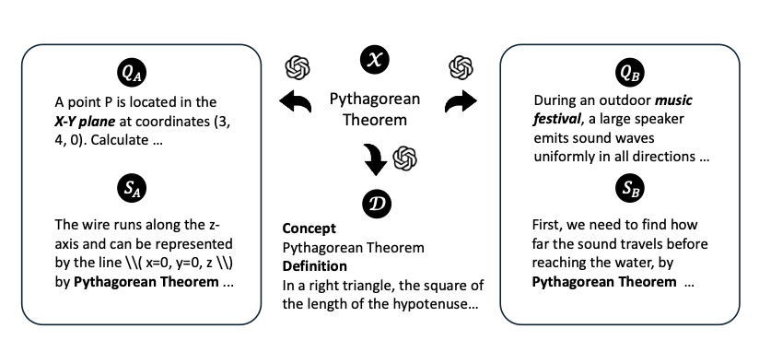
Compare LLM and Diffusion Embeddings
Data Augmentation: Generate Question – passage pairs with seed concepts (ReasonAug)
10,896 triplets
(query, positive, hard negative)
Diffusion vs. Autoregressive Language Models: A Text Embedding Perspective Siyue Zhang, Yilun Zhao, Liyuan Geng, Arman Cohan, Anh Tuan Luu, Chen Zhao, EMNLP 2025 (Oral)

Slide 29
Experimental Setup
DIFFEMBED
We take DREAM-v0-Instruct-7B [1] as the backbone model for DIFFEMBED. Initialized from Qwen2.5-7B, DREAM is pre-trained on 580 billion tokens covering text, code, and math, and achieves performance competitive with leading autoregressive LMs of similar scale.
Similarly sized autoregressive LLMs for comparison
Llama-3-8B
Llama-3-8B with LLM2Vec
Mistral-7B
Mistral-7B with LLM2Vec
Qwen2.5-7B
Qwen2.5-7B with LLM2Vec
Diffusion vs. Autoregressive Language Models: A Text Embedding Perspective Siyue Zhang, Yilun Zhao, Liyuan Geng, Arman Cohan, Anh Tuan Luu, Chen Zhao, EMNLP 2025 (Oral)

Slide 30
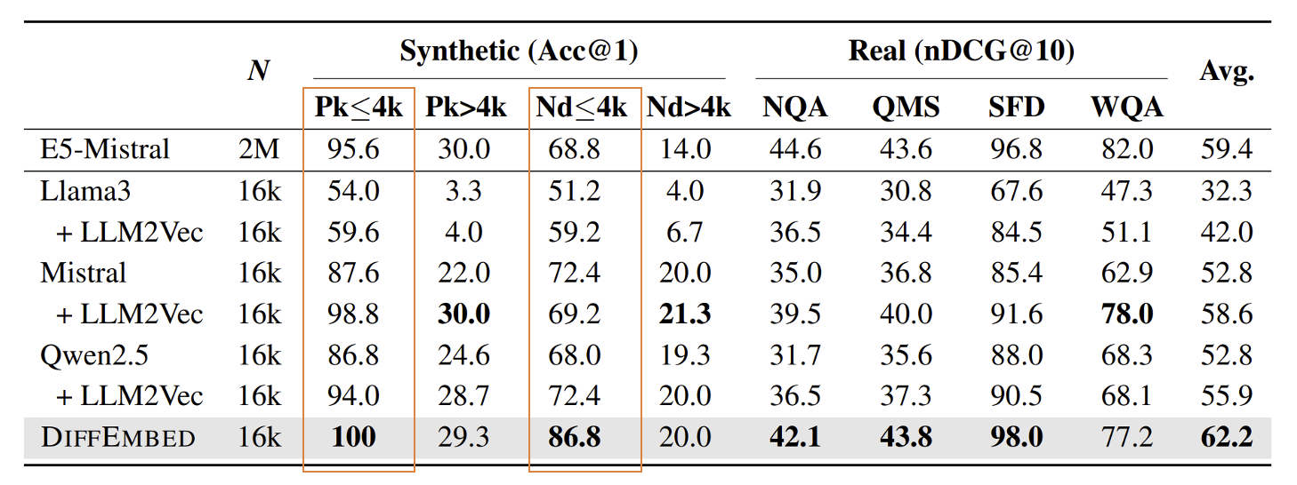
Experimental Results
LongEmb: Long document retrieval
Diffusion vs. Autoregressive Language Models: A Text Embedding Perspective Siyue Zhang, Yilun Zhao, Liyuan Geng, Arman Cohan, Anh Tuan Luu, Chen Zhao, EMNLP 2025 (Oral)

Slide 31
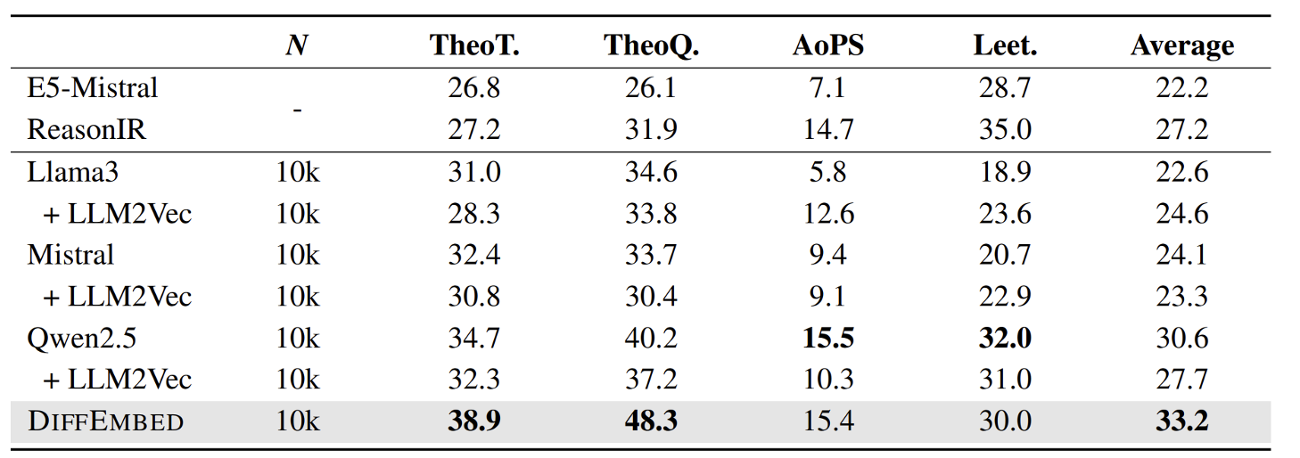
Experimental Results
BRIGHT: Reasoning-intensive Retrieval
Diffusion vs. Autoregressive Language Models: A Text Embedding Perspective Siyue Zhang, Yilun Zhao, Liyuan Geng, Arman Cohan, Anh Tuan Luu, Chen Zhao, EMNLP 2025 (Oral)

Slide 32
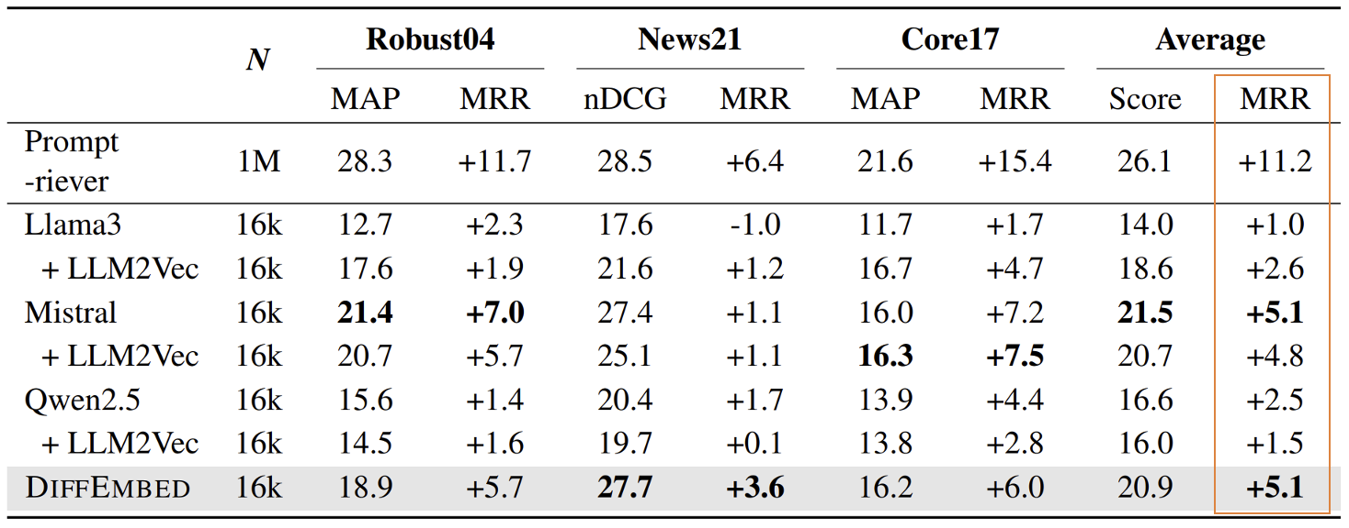
Experimental Results
FollowIR: Instruction Following Retrieval
Diffusion vs. Autoregressive Language Models: A Text Embedding Perspective Siyue Zhang, Yilun Zhao, Liyuan Geng, Arman Cohan, Anh Tuan Luu, Chen Zhao, EMNLP 2025 (Oral)

Slide 33
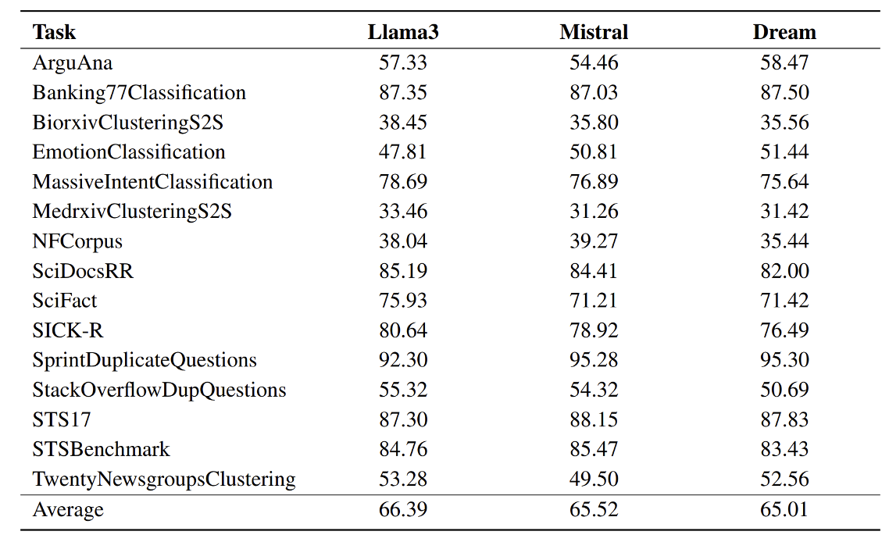
Experimental Results
MTEB: General Text Embedding
Diffusion vs. Autoregressive Language Models: A Text Embedding Perspective Siyue Zhang, Yilun Zhao, Liyuan Geng, Arman Cohan, Anh Tuan Luu, Chen Zhao, EMNLP 2025 (Oral)

Slide 34
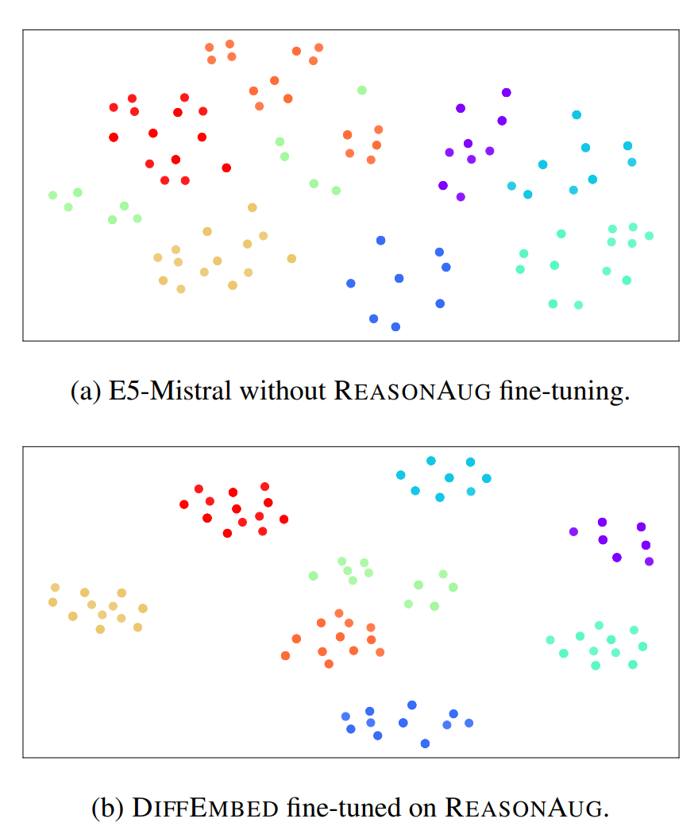
Why LLM embeddings underperform?
t-SNE visualization of document embeddings from REASONAUG. The documents are grouped and color-coded by concept.
Diffusion vs. Autoregressive Language Models: A Text Embedding Perspective Siyue Zhang, Yilun Zhao, Liyuan Geng, Arman Cohan, Anh Tuan Luu, Chen Zhao, EMNLP 2025 (Oral)

Slide 35
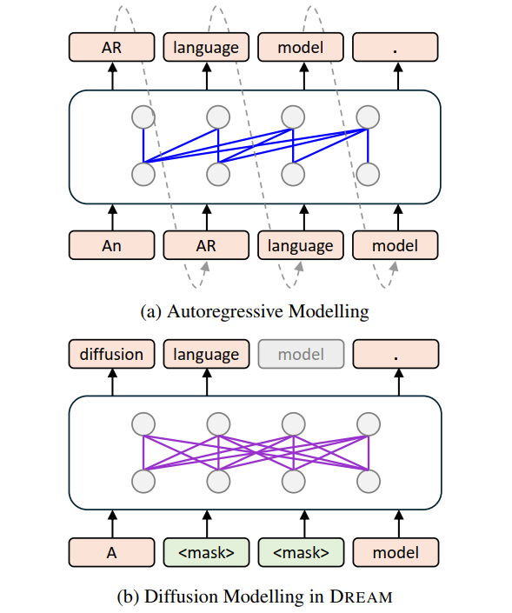
Takeaways
AI for Research with better agentic search systems
Text Diffusion Language Model for Reasoning-intensive Retrieval
(EMNLP 2025)
We claim that embeddings from diffusion LMs are fundamentally better than those from AR-LLMs. Since it can better capture global information.
Empirically it works well. With same amount of training data, diff-Embedding significantly outperforms AR-Embedding counterparts.
Text diffusion model could be the next frontier architecture, we should explore more on it!

Slide 36
Outline
AI for Research with better agentic search systems
Text Diffusion Language Model for Reasoning-intensive Retrieval
(EMNLP 2025)
Benchmarking and Improving Retrieval for Deep Research Agents
(ACL 2026 Submission)
Knowledge G.
Future Directions

Slide 37
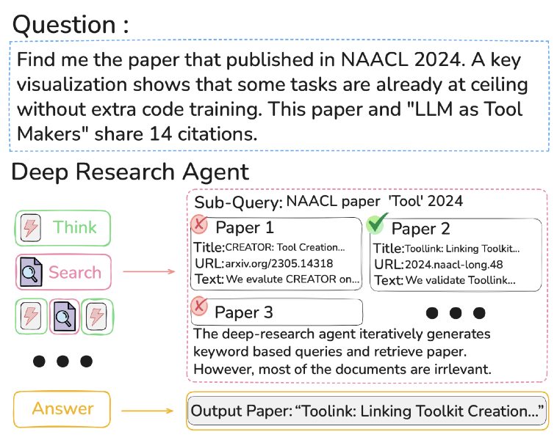
Task: Deep Research Agent for Scientific literature Search
Challenge task for DRAs
Precision: Output papers should satisfy user needs
Recall: Should include diverse set of output papers
SAGE: Benchmarking and Improving Retrieval for Deep Research Agents, Tiansheng Hu, Yilun Zhao, Canyu Zhang, Arman Cohan, Chen Zhao, ACL 2026 Submission

Slide 38
Challenges for State-of-the-art DRAs
Existing DRAs adopt proprietary search APIs over large web corpora.
Web search mainly relies on keywords matching, limiting both precision and broadness.
The web corpora is huge, unable to understand to what extent stronger embedding based retrievers would help.
SAGE: Benchmarking and Improving Retrieval for Deep Research Agents, Tiansheng Hu, Yilun Zhao, Canyu Zhang, Arman Cohan, Chen Zhao, ACL 2026 Submission

Slide 39
Challenges for Benchmarks
There are few existing datasets available.
The papers in the previous datasets are outdated.
E.g., Asking about the BERT paper
Scientific literature is a rapidly evolving field. Up-to-date papers as corpus is necessary.
SAGE: Benchmarking and Improving Retrieval for Deep Research Agents, Tiansheng Hu, Yilun Zhao, Canyu Zhang, Arman Cohan, Chen Zhao, ACL 2026 Submission

Slide 40
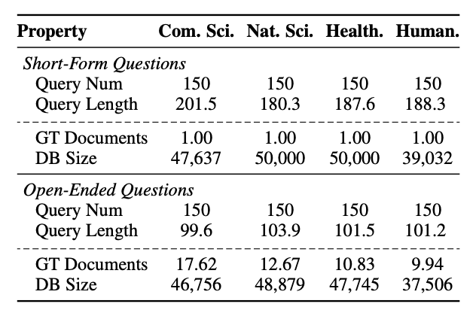
Our benchmark: SAGE
1,200 questions including short-form and open-ended questions.
Four diverse domains.
~50K up-to-date papers likely not in LLM pre-training corpus.
SAGE: Benchmarking and Improving Retrieval for Deep Research Agents, Tiansheng Hu, Yilun Zhao, Canyu Zhang, Arman Cohan, Chen Zhao, ACL 2026 Submission

Slide 41
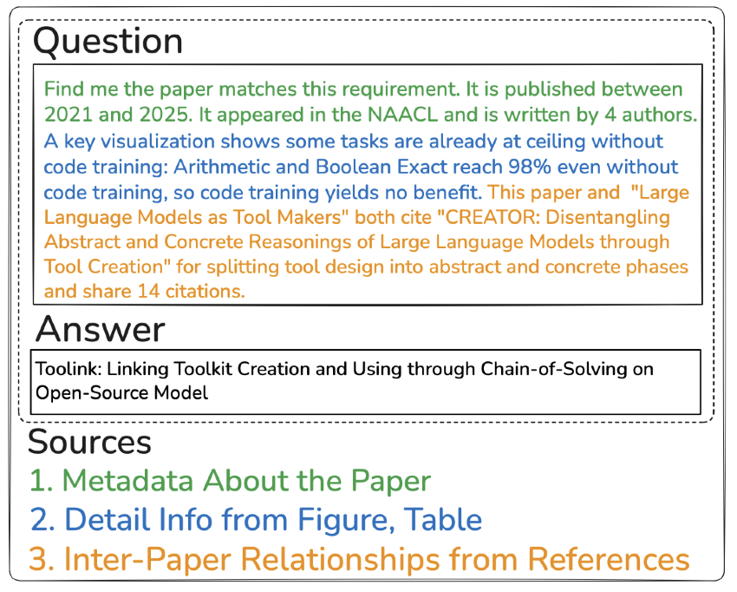
Our benchmark: SAGE Short-form Questions
Require intensive reasoning over metadata, paper details, and inter-paper relationships.
Single answer, therefore easily verifiable.
Seed papers after year 2024.
SAGE: Benchmarking and Improving Retrieval for Deep Research Agents, Tiansheng Hu, Yilun Zhao, Canyu Zhang, Arman Cohan, Chen Zhao, ACL 2026 Submission

Slide 42
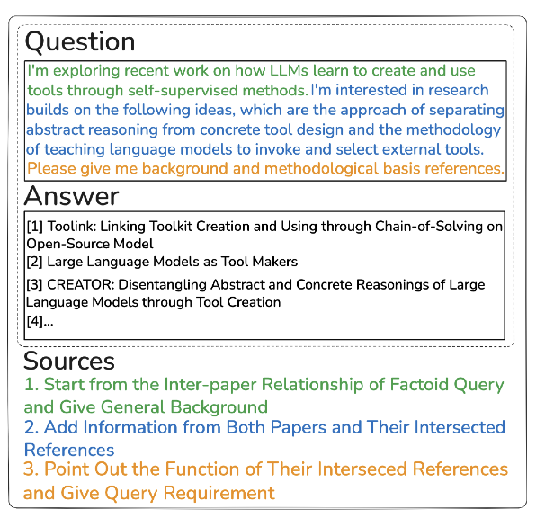
Our benchmark: SAGE Open-ended Questions
Grounded on real-scenarios, e.g., researchers search related work for a new domain.
Long-form answers: List of papers.
Discrete relevant scores: Most Relevant, Relevant, and Not Relevant.
SAGE: Benchmarking and Improving Retrieval for Deep Research Agents, Tiansheng Hu, Yilun Zhao, Canyu Zhang, Arman Cohan, Chen Zhao, ACL 2026 Submission

Slide 43
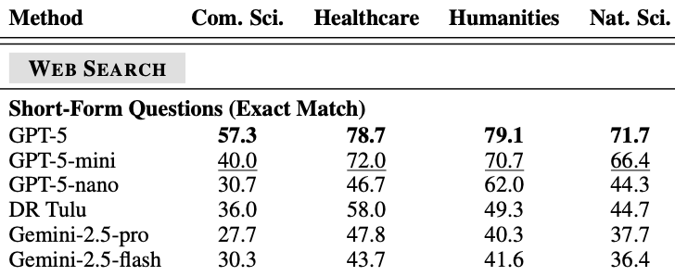
Experiment: How Existing DRAs work on SAGE?
GPT-5 leads on short-form questions.
Open-source DRAs achieve reasonable performance.
SAGE: Benchmarking and Improving Retrieval for Deep Research Agents, Tiansheng Hu, Yilun Zhao, Canyu Zhang, Arman Cohan, Chen Zhao, ACL 2026 Submission

Slide 44
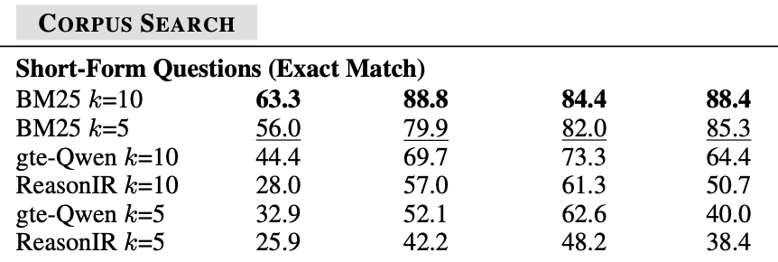
Experiment: Evaluate retrieval behaviors
Using DR TULU as backbone DRA, evaluate different retrievers.
BM25 significantly outperforms LLM embeddings.
One hypothesis: Paper search requires encoding and representing long documents, and existing retrievers struggle.
SAGE: Benchmarking and Improving Retrieval for Deep Research Agents, Tiansheng Hu, Yilun Zhao, Canyu Zhang, Arman Cohan, Chen Zhao, ACL 2026 Submission

Slide 45
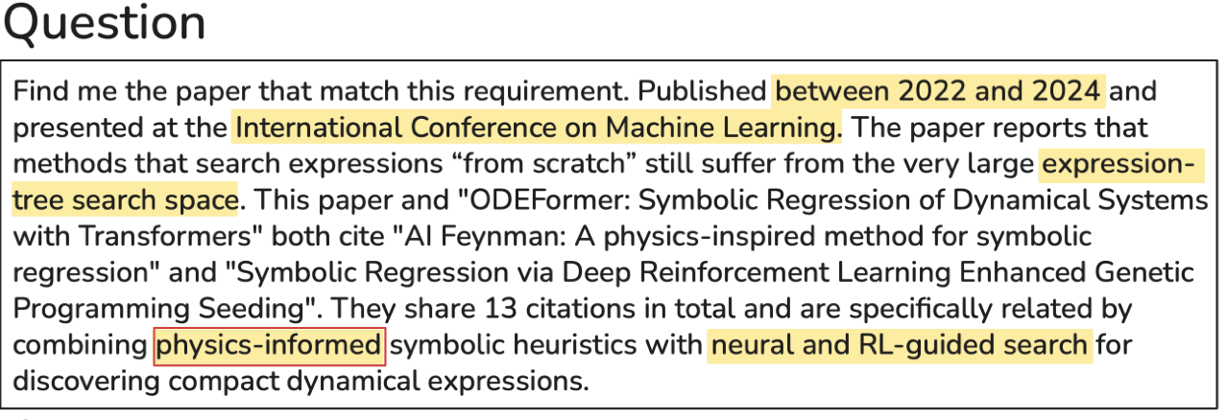
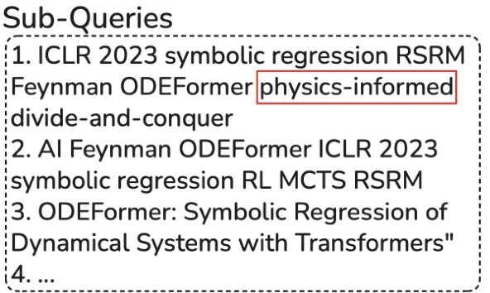
DR TULU only generates Keyword based queries
The sub-queries from DR TULU are bag of keywords.
Hypothesis 2: Keywords based sub-queries favor BM25 over LLM embeddings.
SAGE: Benchmarking and Improving Retrieval for Deep Research Agents, Tiansheng Hu, Yilun Zhao, Canyu Zhang, Arman Cohan, Chen Zhao, ACL 2026 Submission

Slide 46
Our method: Test-time Corpus Scaling
Existing work (Shao et al. 2025) augments query with reasoning chains as test-time scaling.
We propose an alternative form of test-time scaling: scaling the document side
We incorporate reasoning-derived information into documents.
Including metadata and topic-relevant keywords.
Could further extend to other aspects: e.g., use LLMs to edit the papers
Our intuition: The new information could make retrieval easier.
SAGE: Benchmarking and Improving Retrieval for Deep Research Agents, Tiansheng Hu, Yilun Zhao, Canyu Zhang, Arman Cohan, Chen Zhao, ACL 2026 Submission

Slide 47
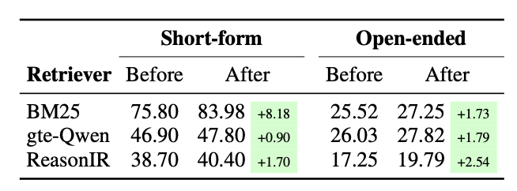
Experiments on Test-time Corpus Scaling
BM25 benefits most from corpus scaling.
The improvements on open-ended questions are limited, one reason is that the generated sub-queries from DR TULU lacks diversity.
SAGE: Benchmarking and Improving Retrieval for Deep Research Agents, Tiansheng Hu, Yilun Zhao, Canyu Zhang, Arman Cohan, Chen Zhao, ACL 2026 Submission

Slide 48
Takeaways
AI for Research with better agentic search systems
Benchmarking and Improving Retrieval for Deep Research Agents
We build a new dataset for scientific literature search with multiple domains and up-to-date papers.
We use our dataset to evaluate retrieval performance, and find that BM25 significantly outperforms LLM embeddings.
We propose a test-time corpus scaling approach that augments the corpus to make retrieval easier.

Slide 49


Overview of Future Directions
Incorporate retrieval advancements for robust Agentic Search systems
Human-agent Collaboration
Future
Multi-turn Interaction
Agentic Search
Responsible Deployment
Knowledge G.
…

Slide 50


Multi-turn Deep Research
Turn 1
Turn 2
Could you research the popular climbing shoes on the market?
Can you revise the report by organizing the shoes you introduced by categories?
Notable Climbing Shoes in 2025
- La Sportiva Solution
Features: Aggressive Downturn…
- La Sportiva Skwama
Features: …
…[16 other shoes omitted]...
How Shoe Features Translate to Climbings Performance
Downturn and asymmetry: …
Rubber compound: … softer rubber improve friction for smearing
Notable Climbing Shoes in 2025 Organized by Categories
Category 1: Neutral to Moderate All-Around Shoes
- Evolv Defy
Features: Plush tongue, hook-and-loop closure
- La Sportiva Taranlulace
Category 2: Aggressive Shoes
- Tanaya Lati
Features: Stiff rubber …
… [20 Other shoes omitted] …
Inconsistent list of shoes
Missing section
Current work with Bingsen Chen, Boyan Li, Xi Ye

Slide 51
Final Take-aways
AI for Research with better agentic search systems
1. Find interesting problems that retrieval actually help.
2. Stronger retrievers that can handle complex and reasoning-intensive queries.
3. (Future) Incorporate retrieval advancements into agentic search
Text Diffusion Language Model for Reasoning-intensive Retrieval
(EMNLP 2025)
Benchmarking and Improving Retrieval for Deep Research Agents
(ACL 2026 Submission)
Notes:
My long term research goal is to equip natural language intelligent agents with reasoning capacities, and to make these reasoning agents robust in the wild.

Slide 52

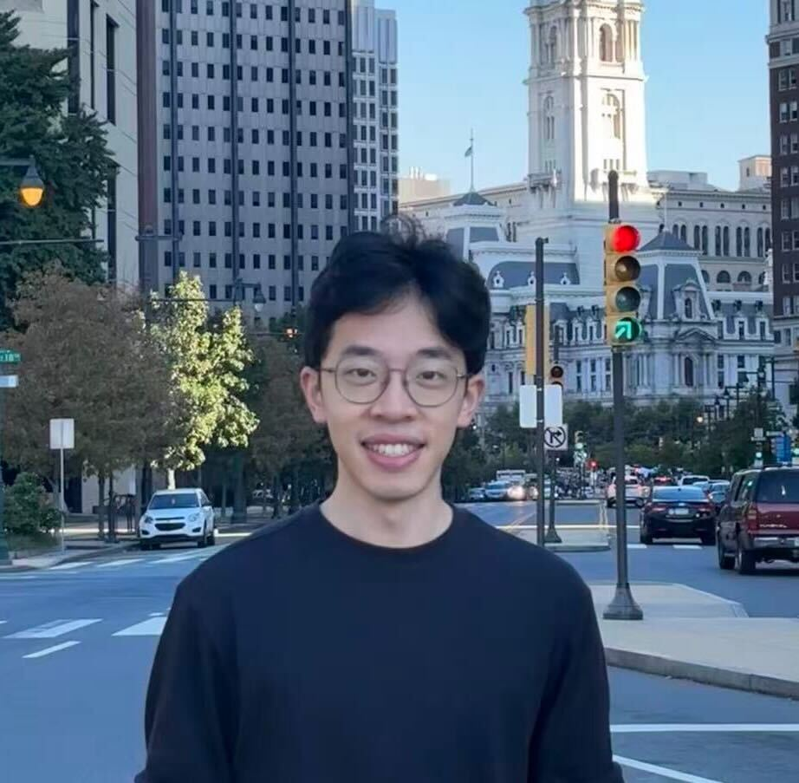
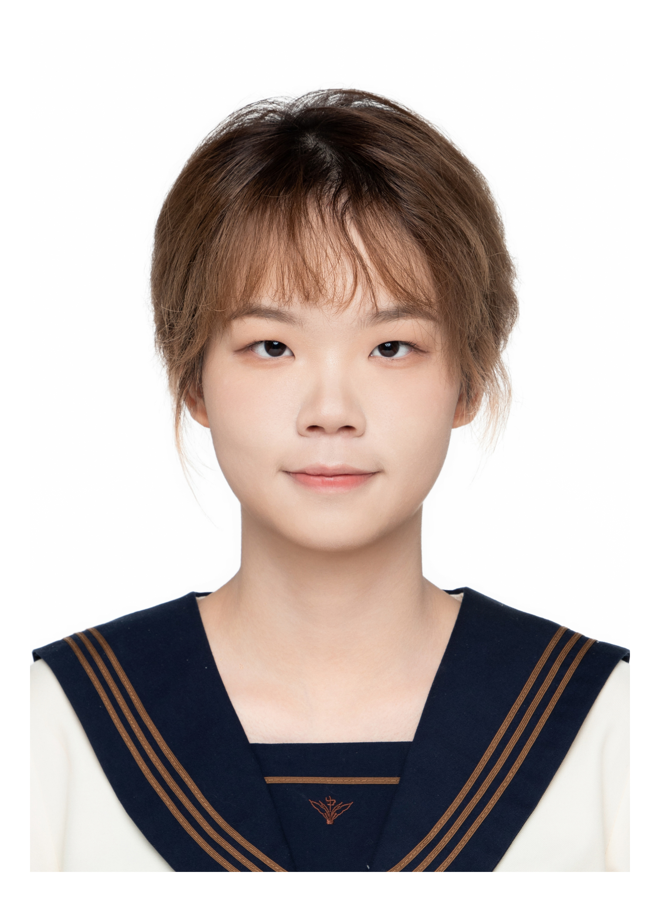
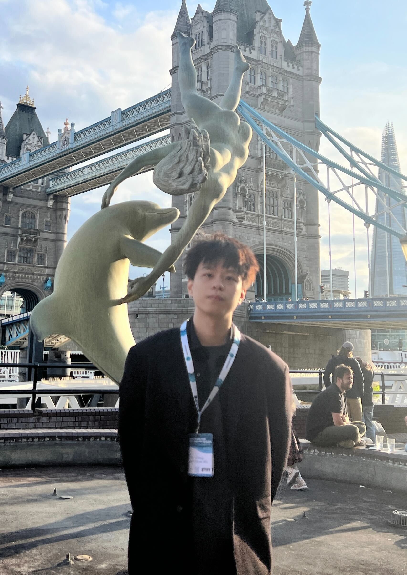
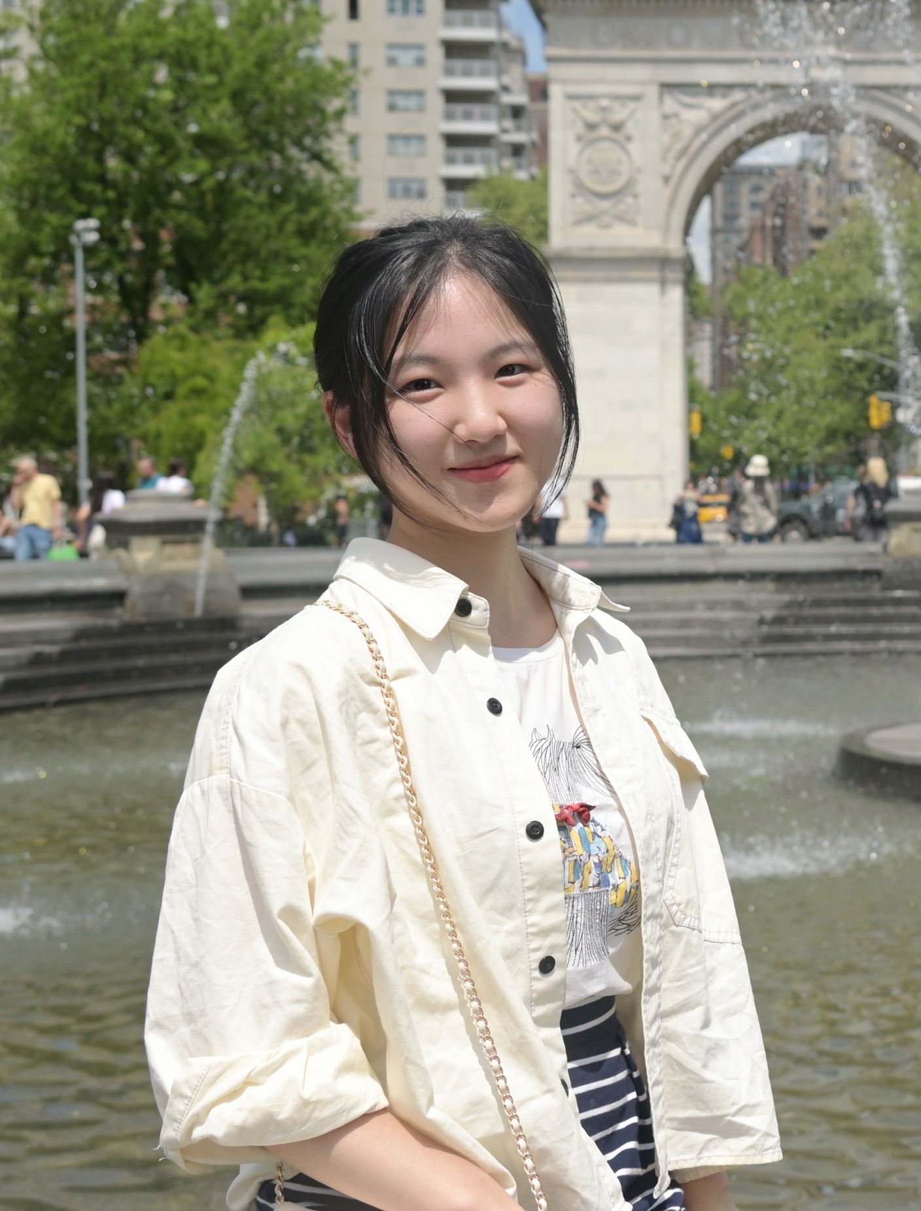
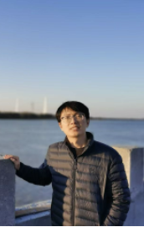
Our Group works on diverse topics related to LLMs, happy to chat!
PhDs
Yulin Chen
Reasoning
Bingsen Chen
Agentic Search
Hongjun Liu
Multimodal Agents
Yihuai Hong
Interpretability
Ziyun Yu
Medical Agents
Siyue Zhang
Visiting from NTU Singapore, Agentic Search
Fantastic Undergrads from NYU Shanghai: Yufeng Xu, Class of 2026, Kaiyue Feng, Class of 2026, Tiansheng Hu, class of 2027, Yiyi Chen, Class of 2027, Qi Sun, class of 2027, Adella Hu, class of 2028, Fengyu Xie, class of 2028

